Slide 1


US Sales Data
Analysis of Adidas's sales data in the US market

Slide 2

Adidas's US Market Presence
Market Share
A detailed overview of Adidas's US sales presence

Slide 3
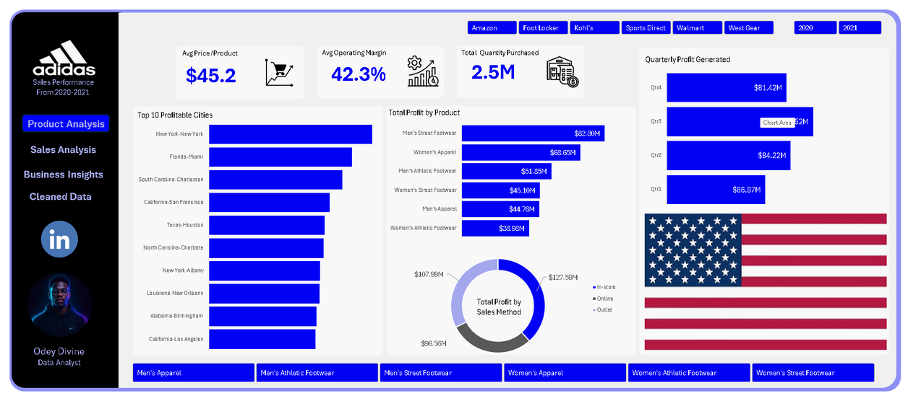
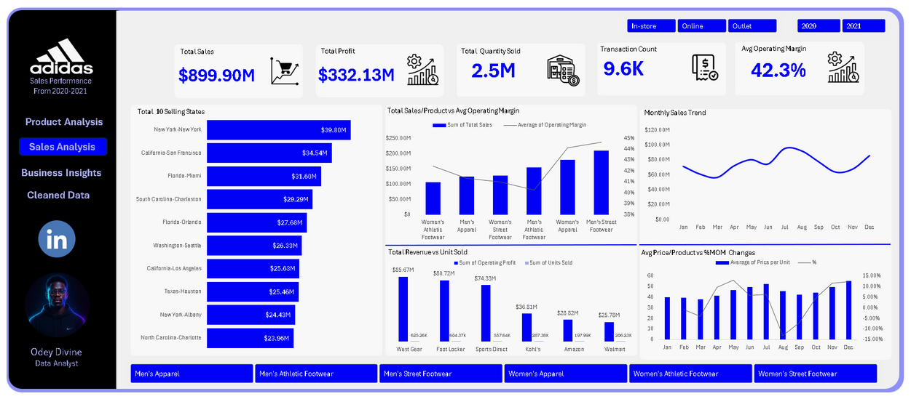
Product Analysis
Sales Analysis

Slide 4
Exploratory Data Analysis
Total Sales: $899.9M
Total Unit Sold: 2.5M
Total Profit Made: $332.1M
Total Transaction Initiated: 9.6K
Average Price Per Product: $45.22

Slide 5

Key Insights
01
Adidas’ in-store sales remain its strongest revenue channel, but the online segment shows growth potential.
02
The Western U.S. is the brand’s dominant market and should continue receiving targeted marketing investments
03
High-margin categories like Men’s Street Footwear and Women’s Apparel should be prioritized for seasonal
promotions.

Slide 6
Recommendations
01
Enhance Online Presence: Increase marketing spend on digital platforms to improve online conversions.
02
Regional Expansion: Leverage success in Western and Northeastern regions to inform store placement
and supply strategies.
03
Product Focus: Continue optimizing inventory and promotions for high-profit items like Men’s Street Footwear.
Price Strategy: Review pricing for lower-performing categories to maintain competitiveness and margin stability
04

Slide 7



Thank You
Odey Divine
Data Analyst

